Slide 1
Accelerants In Your Environment

Slide 2
Accelerants ...
Definition: A substance used to accelerate speed up a process (such as the spreading of a fire)

Slide 3
About...
Me and Calvary
TechOps Manager at Calvary Church
2,000-2,500 weekend attendance
4 campuses (w/ online)
50+ staff
Rock Migration and Go-Live Fall 2017
Rock-driven public site launch July-August 2019

Slide 4
Rock Accelerants
Tools, Tips, Shortcuts
Moving from Hey it works! to Wow, what an impact
Rock Shop Plug-ins
Community
Rock tools that work for us
Sandbox methodology
Thinking/Mindset
>fire

Slide 5
Accelerant 1: Rock Shop Plug-ins
The plug-in Rock Shop Notifications is a must-have
What we use that directly impacts ministry:
Prayer Email Digest, Room Management, PCO Sync, Survey System, Signup Wizard
What we use to keep things humming:
Group Type Change Tool, Azure Storage Provider, SQL Map, Switchvox PBX, Cloudinary Storage Provider, Acme Certificate, Redirector, Lava Tester, Wistia Integration, Rock Shop Notifications

Slide 6
Accelerant 2: Rock Community
Develop a Rock Star; someone your organization expects to be investing in the Rock community
Promote Rock Chat (to any and all staff and volunteers)
Q&A; subscribe, check periodically
Recipes; Learned something in your org? Share it!
Ideas; share your great idea with the Rock community and Spark

Slide 7
Accelerant 3: Core Rock Tools Dynamic Data Block (DDB)
Ways we are using the DDB:
Staff Birthdays (on Internal Homepage)
Weekly Finance Reporting (detailed in the recipe Creating A Clean, Customized Finance Weekly Report)
Giving History and Projection (from the recipe Projected Year End Giving)

Slide 8
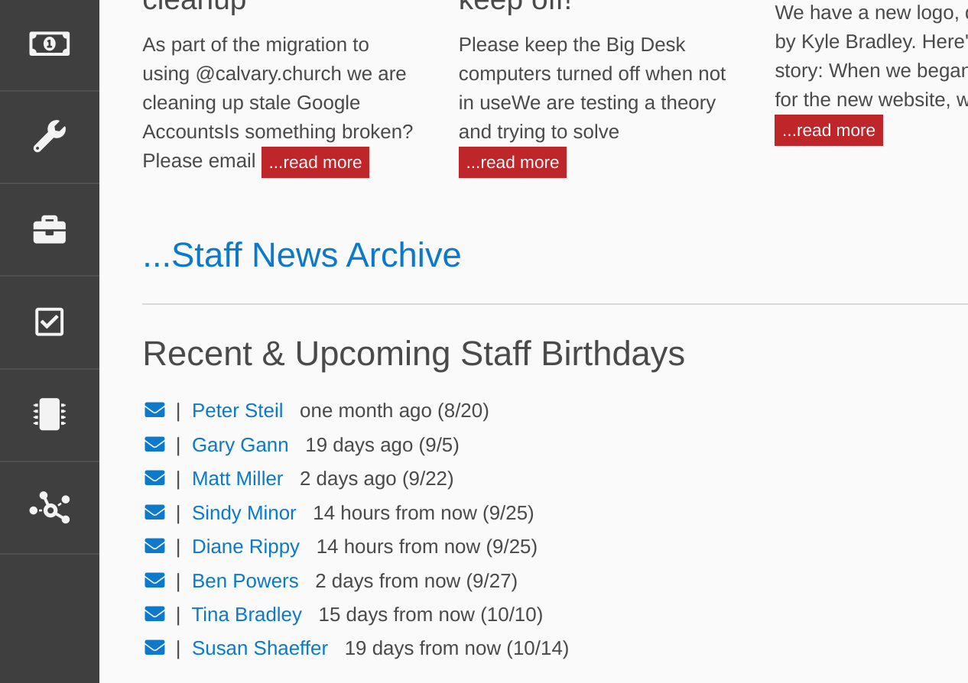

Slide 9
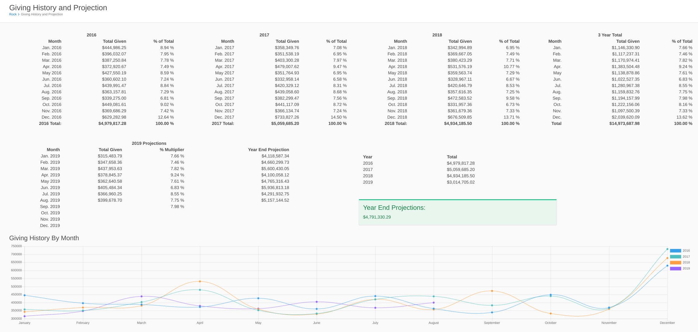

Slide 10
Accelerant 3: Core Rock Tools Content Channels
Usage limited by your imagination
Ways we use:
Documentation: Rock, TechOps, Operations processes
Training
Check out the Recipes for more inspiration

Slide 11
Accelerant 3: Core Rock Tools Lava
Use Lava tester to learn. rockrms.com/lava , Q&A and Rock Chat #Lava channel are your friends
Current favorite:
Link 2 registrations based on a registration attribute. if the registrant needs childcare, auto-link and start the childcare registration autommatically after the registrant completes their registration

Slide 12
Accelerant 4: Sandbox
What is a sandbox?
A Sandbox is a Rock server with a copy of your live/production Rock data

Slide 13
Accelerant 4: Sandbox
Building a sandbox
Use a process to make a copy of your production environment to the sandbox server
Create distinctive markers so users know they are using the sandbox
Put protections in place as needed. Candidates: Email & sMS Communications, Disable plug-ins, evaluate all page
We use an Azure B2Ms sized VM for sandbox (SQL & IIS)
Rock Partners, ChurchIT Network can help with building

Slide 14
Accelerant 4: Sandbox
Use cases for a sandbox
As you train staff, this is the proving ground to demonstrate Rock literacy
When considering a structure change to Rock, sandbox it first (Group Structure, Group Types, Reporting, DDB,

Slide 15
Accelerant 5: Thinking/Mindset
Small changes consistently wins over big changes infrequently
Find books to challenge your thinking
Finish by Jon Acuff
Customer Service Survival Kit by Gallagher
Heath Brothers
Encourage people to air the frustrations/shortcomings/rough edges
Are you approachable enough for your pastors to tell you they don’t know what a dataview is?

Slide 16
Bonus Accelerant: Leadership Buy-in
Who is the Rock advocate at the senior leadership level?
Who is keeping an eye out for organizational-level challenges, and can help evaluate and advocate for Rock helping with those

Slide 17
Done!
Contacting me:
Rock Chat: @sross
Twitter: @sgtserve
ChurchIT Network Slack: @sross
email: sross@calvary.church
>fire

